Slide 1

P peline
The Data
Visualizing and Exploring Big Data
© Jennifer Mankoff
The Data Pipeline; HCII; Spring 2014

Slide 2
What is Big Data?
Mining Massive Data Sets: http://www.stanford.edu/class/cs246 Book free online: http://i.stanford.edu/~ullman/mmds.html#latest
Want to do it yourself in Python? Jurney’s ‘Agile Data Science’ will get you to a web app analyzing your gmail
Want to understand the tradeoffs in systems and platforms? Manoochehri’s ‘Data Just Right’
Notes:
Too much to cover it all in this class!

Slide 3
How do we handle big data
Two approaches
Distribute the work (parallelize)
Break the work up into smaller batches
Algorithms that can operate on partial data sets are key

Slide 4
Case Study [Bad Data Handbook Ch 12]
Studying online text data (NLP)
Scraped data into Apache CouchDB
JSON based
Schema-less / Document oriented
HTTP support
Supports MapReduce
Collected 70GB of blog posts
[McNamara]

Slide 5
Case Study [Bad Data Handbook Ch 12]
Poor debugging experience
Error output poor
MapReduce errors occurred only at reduce stage (slow debug cycle)
Indexing data took days; failures could occur at any point
-> Fast write, slow & difficult querying

Slide 6
Relating infrastructure solutions to the Data Pipeline
Understand your data problem first
Outsource things that aren’t key to your contribution
Start small -- test on a subset of data to find basic problems first
Plan to scale up

Slide 7
Relating infrastructure solutions to the Data Pipeline
Collecting Data: File System? Or Redis [write heavy]

Slide 8
Relating infrastructure solutions to the Data Pipeline
Collecting Data: FS/Redis [write heavy]
Organizing and Processing for future needs: Hadoop/Map Reduce related tools [flexible, not always efficient, not enterprise-ready]
Lacks automated backups
Lacks interoperability with existing filesystems
Better for batch than interactive tasks

Slide 9
Relating infrastructure solutions to the Data Pipeline
Collecting Data: FS/Redis [write heavy]
Organizing and Processing for future needs: Hadoop/Map Reduce related tools [flexible, not always efficient, not enterprise-ready]
Summarization: Google Big Query
In the cloud
Network speed a limiting factor

Slide 10
Relating infrastructure solutions to the Data Pipeline
Collecting Data: FS/Redis [write heavy]
Organizing and Processing for future needs: Hadoop/Map Reduce related tools [flexible, not always efficient, not enterprise-ready]
Summarization: Google Big Query
Machine Learning: Parallelize & Distribute

Slide 11
Machine Learning in Parallel
Distributed machine learning
Mahout [uses Hadoop]: supports clustering, classification and collaborative filtering
MLBase: In-memory solution that chunks data and incrementally adds it to the training.
Python + NumPy [in memory] + SciPy [in memory] + Pandas [support many things]
iPython in parallel
Notes:
http://pandas.pydata.org/
http://strata.oreilly.com/2013/03/python-data-tools-just-keep-getting-better.html
http://cloudcelebrity.wordpress.com/2012/04/25/machine-learning-libraries-in-python/

Slide 12
Relating infrastructure solutions to the Data Pipeline
Collecting Data: FS/Redis [write heavy]
Organizing and Processing for future needs: Hadoop/Map Reduce related tools [flexible, not always efficient, not enterprise-ready]
Summarization: Google Big Query
Machine Learning: Parallelize & Distribute
Visualization: Google Big Query + D3

Slide 13
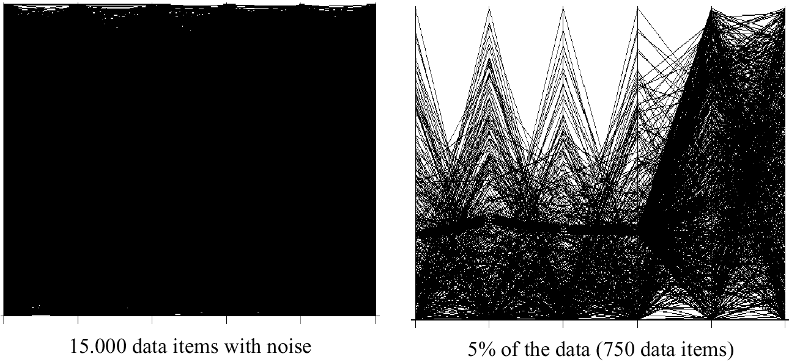
Exploring Big Data

Slide 14
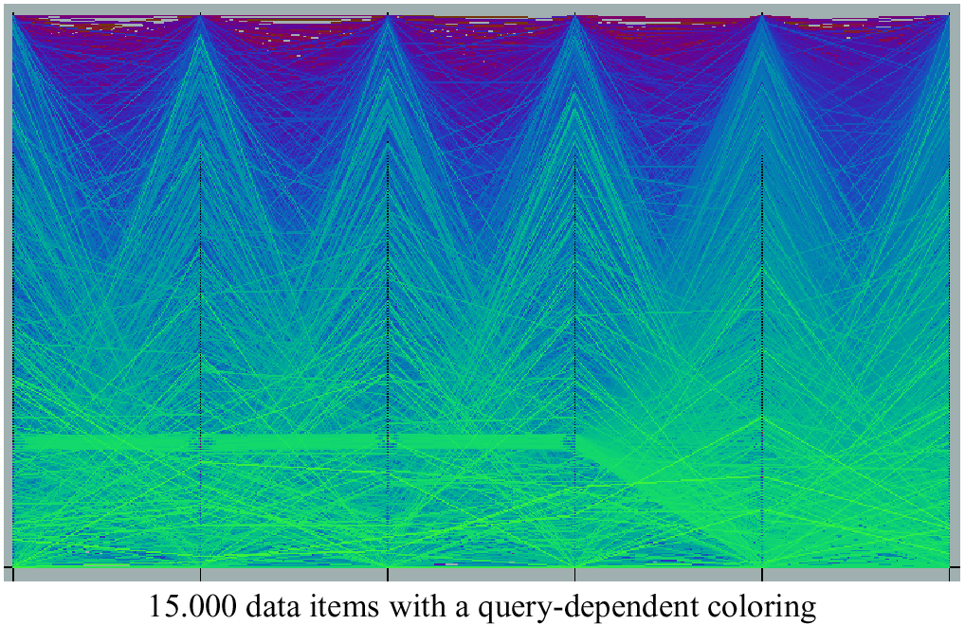
Query Dependent Coloring

Slide 15
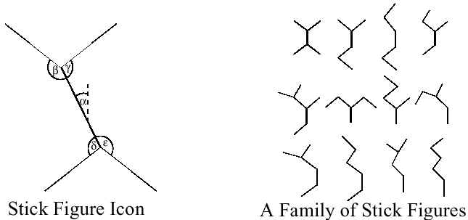
Stick Figures
Notes:
Visualization of the multidimensional data using stick figure icons
Two attributes of the data are mapped to the display axes and the remaining at-tributes are mapped to the angle and/or length of the limbs
Texture patterns in the visualization show certain data characteristics

Slide 16
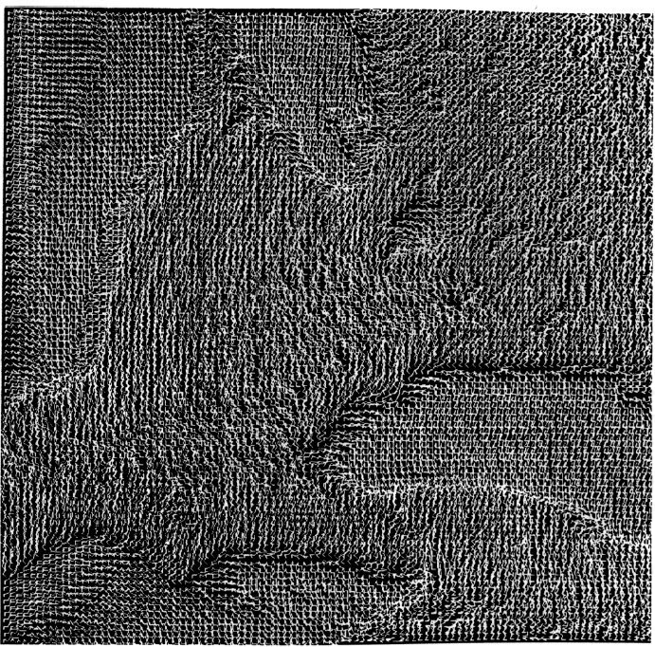
Stick Figures

Slide 17
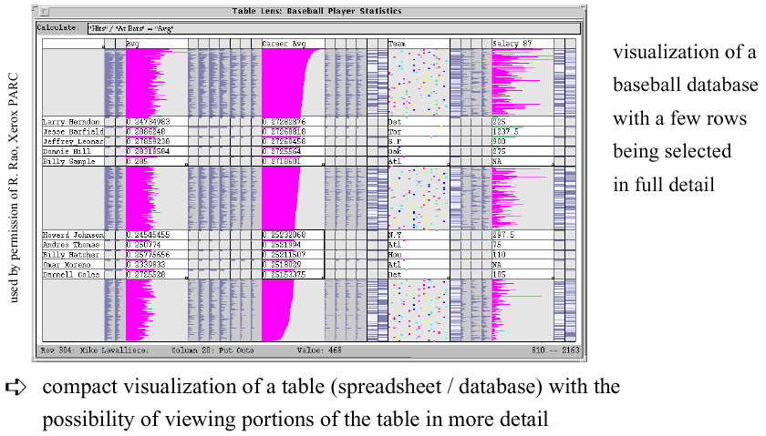
Distortion Techniques
Notes:
Table Lens

Slide 18
Distortion Techniques
Basic Idea: Distortion of the image to allow a visualization of larger amounts of data
Simple:
Perspective Wall [MRC91]
Bifocal Displays [SA 82]
TableLens [RC94]
Graph. Fisheye Views [Fur 86, SB94]
Hyperbolic Repr. [LR94, LRP95]
Complex:
Hyperbolic Repr. [LR94, LRP95]
3D-Hyperbolic Repr. [MB95]
Hyperbox [AC91]

Slide 19
How to use Visualization to Answer Your Questions
Visualization for you:

Slide 20
Goals
Summarizing the Data
Summary Tables
Descriptive statistics
Graphs
Finding Hidden Relationships
Asking specific questions
Correlations
Grouping
[eventually] Making Predictions

Slide 21
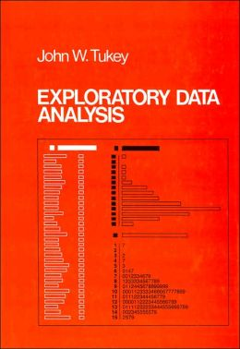
Visual Tool Chest: Stem and Leaf
Tukey’s tool of choice first
Easy to do by hand
Careful design adds value

Slide 22
Example: Stem and Leaf of Zip
Digit reminder representation
40224 24 24 24
40227 27 27
40220 20 20 20 20 20 20 20 20 20 … [138]
…
Notes:
Have them do an exercise in class

Slide 23
Wide Range of Uses (e.g.)
 |  | <6mo | 6mo-1y | 1-6 | 7+
 | ☐ | . . | . . | ☒ . . | ☐
Lost Reported Expired | ☒ ☒ ☒ ☒ ☒ ☒ ☒ ☒ ☒ ☒ ☒ ☒ ☒ ☐ | . |  | . | .
Foster | ☒ ☒ ☐ | ☒ ☒ ☒ ☒ ☒ ☒ ☒ ☒ ☒ ☒ ☒ ☒ . | ☒ ☒ . | ☒ ☒ ☒ ☒ ☒ ☒ ☒ ☐ | ☒ ☐
Missing | ☐ . | . . |  |  | . .
Returned to Owner | ☒ ☒ ☒ ☒ ☒ ☒ ☒ ☒ ☒ ☒ ☒ ☒ ☒ ☒ ☒ ☒ ☒ ☒ ☒ ☒ ☒ ☒ ☒ ☒ ☒ ☒ ☒ ☒ ☒ ☒ ☒ ☒ ☒ ☒ ☒ ☒ ☒ . . | ☒ ☒ ☒ ☒ ☒ ☒ | ☒ ☒ ☒ ☒ ☒ ☒ ☒ ☒ ☒ ☒ ☐ |  | ☒ ☒ ☒ ☒ ☒ ☒ ☒ ☒ ☒ ☒ ☒ ☒ ☒ ☒ ☒ ☒ ☒ ☒ ☒ ☒ ☒ ☒ ☒ ☒ ☒ ☒ ☒ ☒ ☐
Disposal | ☒ ☒ ☒ ☒ ☒ ☒☐ | . . |  |  | ☒ ☐
Transferred to Rescue
Found Expired
Adopted
Euthanized
Released in Field
No Show
Died

Slide 24
Benefits of Steam + Leaf
Quick & easy to produce; very flexible
Easy to annotate in all sorts of ways; use for comparison (of different samples); etc
Help to highlight unsymmetric trailing off
Help to highlight popular/unpopular values
About where values are ‘centered’
About how widely values are ‘spread’

Slide 25
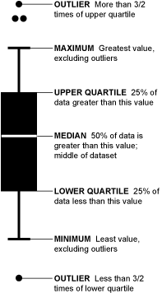
Boxplot
Boxplots make comparison really easy …
Can also show certain types of unexpected structure (e.g. variance variance)
Notes:
http://flowingdata.com/2008/02/15/how-to-read-and-use-a-box-and-whisker-plot/
Note: this is after cleaning…
Boxplots make comparison really easy …
Can also show certain types of unexpected structure (e.g. variance variance)
Created with ‘boxplot-demo.py’
Box is 25%
Line is median
Dots are outliers
Xx update

Slide 26
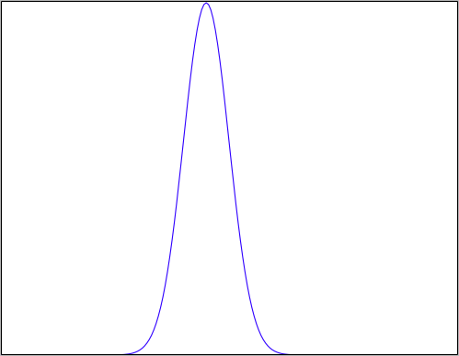
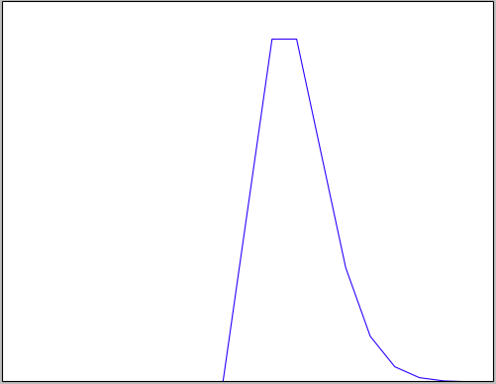
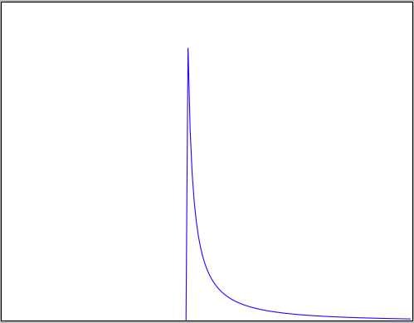
Histograms: Checking a Distribution
Histogram (eyeball)
Example distributions:
Normal
Poisson
Log Normal
Notes:
Example

Slide 27
What your distribution implies: Normal Distribution
Properties:
No long tail (bell shaped)
Symmetric
Mean median & mode equal & in the middle
~68% within 1 SD of mean
~95% within 2 SD of mean
Almost all lie within 3SD of the mean
Histogram looks bell shaped
Notes:
Example

Slide 28
When might we expect a Normal distribution?
Central limit theorem: Sum of independent and identically distributed random variables will converge to normal

Slide 29
Example: Mouse Motion Length
Normal Distribution: Mouse Motion Length across all interactions
Random Variable: An interaction
Discrete or Continuous?
Independence? When might this be true/untrue?
Identical Distributions?
Notes:
Discrete values (“Probability Mass Function”) - typically values and weights
Continues values (“Probability Density Function”) – typically a function
Affects how we model the variable
Insurance claims: Not independent when an epidemic hits the local population (common location affects health)
Identical distributions not the same in terms of chance of being sick when one person has higher likelihood of inheriting a disease or is in a socioeconomic class more at risk for disease

Slide 30
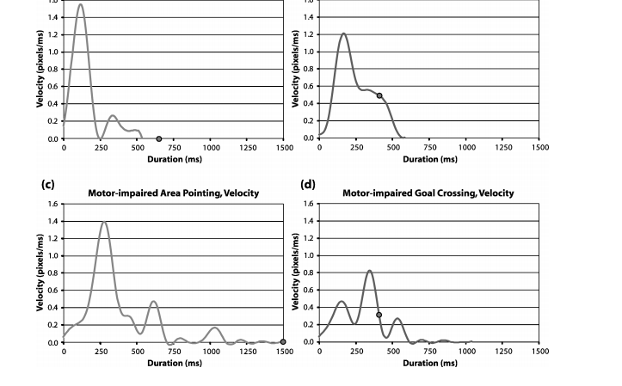
Domain matters: Min-jerk profile
Jacob O. Wobbrock and Krzysztof Z. Gajos. 2008. Goal Crossing with Mice and Trackballs for People with Motor Impairments: Performance, Submovements, and Design Directions. ACM Trans. Access. Comput. 1, 1, Article 4 (May 2008), 37 pages. DOI=10.1145/1361203.1361207 http://doi.acm.org/10.1145/1361203.1361207
Notes:
Fig. 17. Velocity proﬁles over time using the mouse for (a,b) able-bodied participants and (c,d)
motor-impaired participants. The dot represents the click or crossing event. The graphs on the
left are for area pointing. The graphs on the right are for goal crossing.

Slide 31
What your distribution implies: Normal Distribution
Properties:
No long tail (bell shaped)
Symmetric
Mean and median equal & in the middle
~68% within 1 SD of mean
~95% within 2 SD of mean
Almost all lie within 3SD of the mean
Histogram looks bell shaped
Assumptions:
Sum of random variables
Independent
Identically distributed
Notes:
Example

Slide 32
Value of Histograms
Helps you check: Do assumptions match your data?
Gives a sense of the distribution

Slide 33
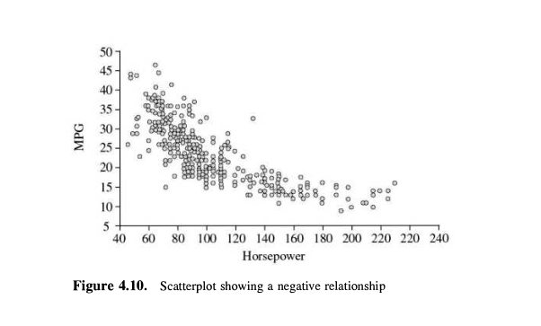
Scatterplot
Notes:
A scatter plot & correlation analysis are measures of association (linear relationship) between two variables
These variables change together
Usually scale (interval or ratio) variables

Slide 34
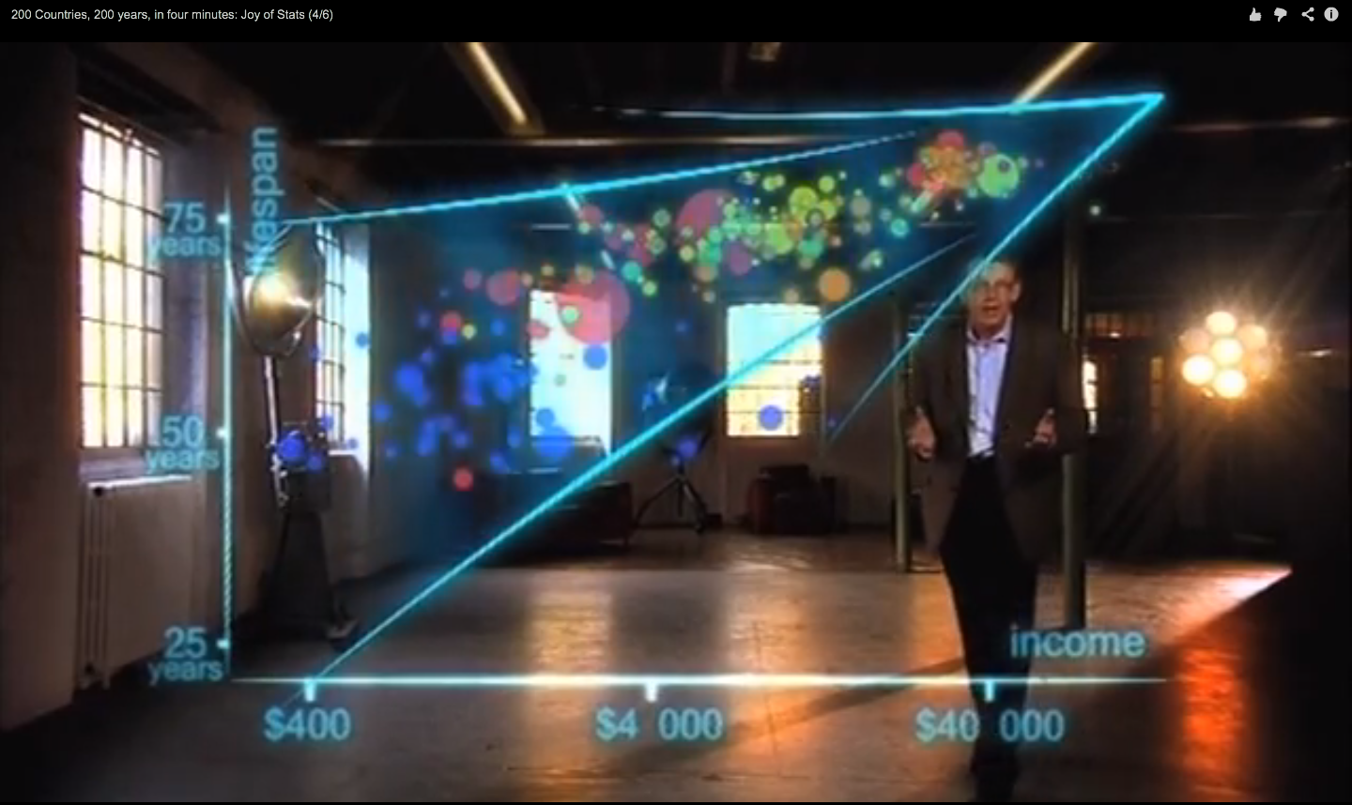
Hans Rosling on Health & Wealth
http://www.youtube.com/watch?v=ahp7QhbB8G4

Slide 35
Scatter Plot Examples
Linear relationships
Curvilinear relationships
y
y
x
x
y
y
x
x
Adapted from http://www.fordham.edu/economics/Vinod/correl-regr.ppt

Slide 36
Scatter Plot Examples
(continued)
Strong relationships
Weak relationships
y
y
x
x
y
y
x
x
Adapted from http://www.fordham.edu/economics/Vinod/correl-regr.ppt

Slide 37
Scatter Plot Examples
(continued)
No relationship
y
x
y
x
Adapted from http://www.fordham.edu/economics/Vinod/correl-regr.ppt

Slide 38
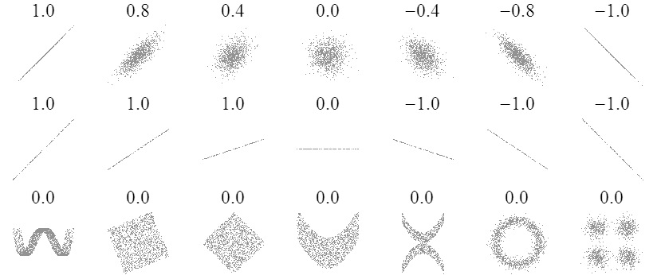
Sample Correlations
Adapted from: http://www.sjsu.edu/people/steven.macramalla/courses/stats95/s1/lecture 10
38

Slide 39
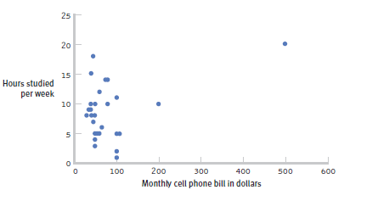
The effect of outliers
One outlier changed the correlation from -0.14 to 0.39!
Adapted from: http://www.sjsu.edu/people/steven.macramalla/courses/stats95/s1/lecture 10
Notes:
Note negative to positive change among other things

Slide 40
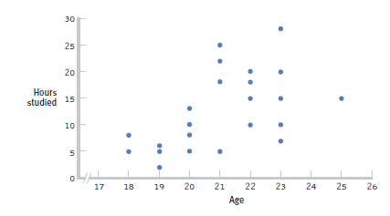
Restricted Range: Sampling Bias
Boys and girls who performed in the top 2% to 3% on standardized
Adapted from: http://www.sjsu.edu/people/steven.macramalla/courses/stats95/s1/lecture 10
Notes:
tests - a much smaller range than the full population from which the researchers could have drawn their sample.

Slide 41
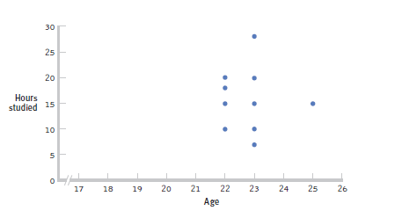
Further Restrictions
Only students between the ages of 22 and 25: r= 0.05.
Adapted from: http://www.sjsu.edu/people/steven.macramalla/courses/stats95/s1/lecture 10

Slide 42
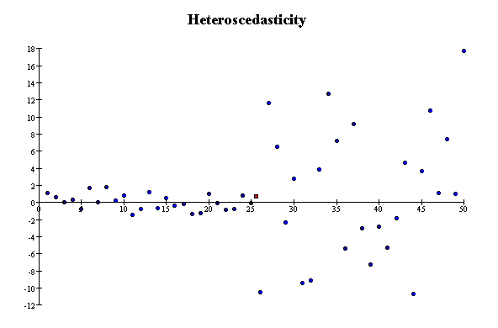
Correlation Assumptions
Key Assumptions:
X values are normally distributed within the population (for each Y)
Y values are normally distributed within the population (for each X)
X and Y have a linear relationship
There are no significant outliers
Scatter doesn’t vary over X or Y

Slide 43
Correlation is not Causation
There is a 0.91 correlation between ice cream consumption and drowning deaths.
Does eating ice cream cause drowning?
Does grief cause us to eat more ice cream?
Adapted from: http://www.sjsu.edu/people/steven.macramalla/courses/stats95/s1/lecture 10

Slide 44
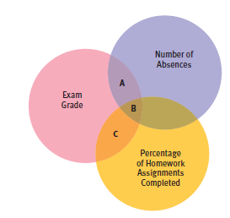
Partial Correlation
Quantifies the degree of association between two variables after statistically removing the association of a third variable with both of those two variables.
e.g., number of absences and exam grade, over and above the correlation of percentage of completed homework assignments with these variables.
Adapted from: http://www.sjsu.edu/people/steven.macramalla/courses/stats95/s1/lecture 10

Slide 45
Example
A study of graduates’ salaries showed negative association between economists’ starting salary and the level of the degree
PhDs earned less than Masters degree holders, who in turn earned less than those with just a Bachelor’s degree
Why?
The data was split into three employment sectors
Teaching, government and private industry
Each sector showed a positive relationship
Employer type was confounded with degree level
Adapted from: http://www.sjsu.edu/people/steven.macramalla/courses/stats95/s1/lecture 10

Slide 46
Simpson’s Paradox
http://en.wikipedia.org/wiki/Simpson's_paradox
Introducing another variable may change our understanding of the data
It may even reverse the initial conclusions

Slide 47
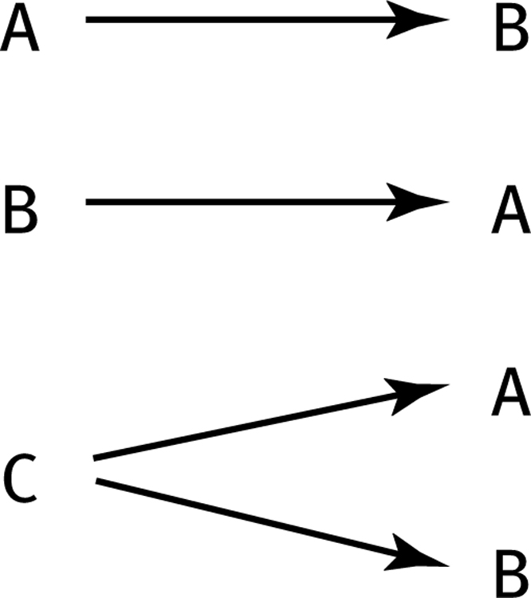
How can we test these associations?
Three Possible Causal Explanations for a Correlation
Adapted from: http://www.sjsu.edu/people/steven.macramalla/courses/stats95/s1/lecture 10

Slide 48
Randomized Trial (gold standard)
Assume A and B_{i} are correlated…
Measure current (A) state)
Activity
Measure (B_{i})

Slide 49
Randomized Trial (gold standard)
Assume A and B_{i} are correlated…
And that Activity links them
Measure current (A) state)
Activity
Measure (B_{i})

Slide 50
Randomized Trial (gold standard)
Recruit Participants
Activity becomes the intervention
Randomize
Measure current (A) state)
Measure current (A) state)
Measure current (A) state)
Intervention Group
Control Group
Activity
Measure (B_{i})
Measure (B_{c})
Measure (B_{i})

Slide 51
Randomized Trial (gold standard)
Recruit Participants
Activity becomes the intervention
Randomize
Measure current (A) state)
Measure current (A) state)
Measure current (A) state)
Intervention Group
Control Group
Activity
Measure (B_{i})
Measure (B_{c})
Measure (B_{i})
Test for significant difference between A & B_{i}; B_{i} and B_{c}; A & B_{c}

